Slide 1
Intro to Python
For Non-Programmers
Pamela Pan, Data Services Fellow
shanghai.library.data@nyu.edu
Fall 2021
NYU Shanghai Library

Slide 2
Welcome to the
first Python Workshop
of the semester!
1. Intro to Python
Comments, Variables, Operators, and Statements
2. Intro to Data Structures
Lists, Tuples, Sets and Dictionaries; Iterations and Functions
3. Intro to Data Analysis
with Python
Basic exploratory data analysis
Notes:
Sharing Link
Download link
More about workshops

Slide 3
Contents
Part I
● What is Python
● The Uses of Python
● Why use Python
● Python VS R
● Python Environments
● Google Colab Notebook
Part II
● Let’s Code!

Slide 4
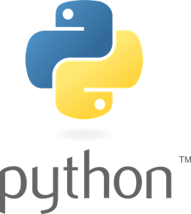
What is Python?
Python is a popular programming language.
Specifically, it is a scripting language.
Shortens up the traditional process (“edit-compile-link-run”) that languages like C, C++, and Java require.
Interpreted, rather than compiled.
It was created by Guido van Rossum, and released in 1991.

Slide 5
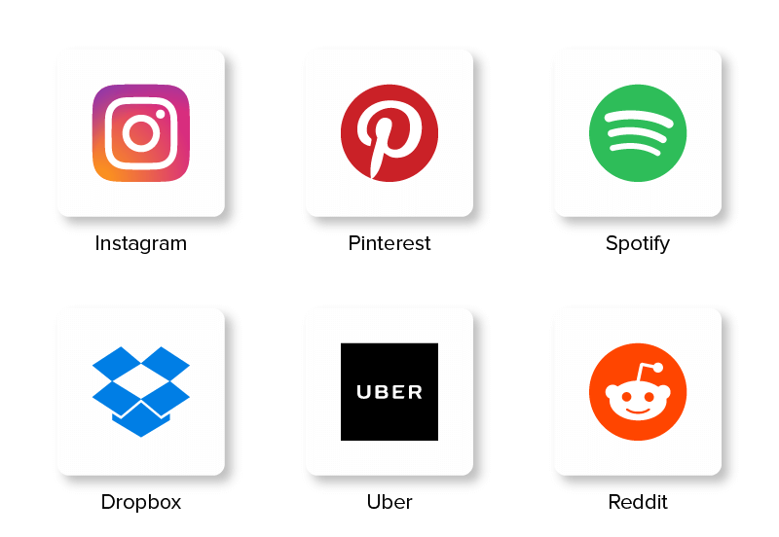
The Uses of Python
Software & Game Development
Web & Internet Development
Scientific and Numeric
Education
Business Applications (ERP, SaaS)
Task automation of any kind
More interdisciplinary uses
Apps built with Python (Django)
Source: Python’s official website

Slide 6
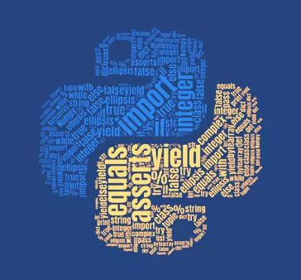
Why Python?
Works on different platforms
Syntax is similar to English
Same task, fewer lines of code
Runs on an interpreter system, meaning that code can be executed as soon as it is written, allowing fast prototyping

Slide 7
Why Python?
Python can be treated in a procedural way, an object-oriented way (OOP) or a functional way.
These are 3 important programming paradigms

Slide 8
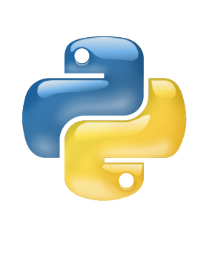

When to use Python or R?
Python
R
Used for data analytics, machine learning, stats;
Supported by Anaconda
Data analysis & Statistics
Commonly used for statistical analysis
Package manager: CRAN (12K packages)
Visualization packages include ggplot2, Shiny.
Software deployment and Production
Provides a general approach to data science
Package manager:
PyPi (141K packages)
Visualization packages include Matplotlib, Seaborn, etc.
*Link to R resources
Notes:
More on deployment: https://www.sumologic.com/glossary/software-deployment/

Slide 9

Python Environments
Terminal (Console/ Command Prompt) → .py files
Built-in for every system (Mac, Linux, Windows)
How to open a console?
Integrated Development Environment (IDE) → .py files
Spyder
PyCharm
Visual Studio Code (VS Code)
Thonny
Netbeans
Interactive Computational Environment (ICE) → .ipynb files
Markdown (Text) + Code
Jupyter Notebook (Intro slides)
Google Colab Notebook → what we will use today!
Jupyter notebooks that are hosted by Colab.
Where you could launch all of these environments and useful packages
Install | Navigator Guide
Notes:
Jupyter Notebook: https://guides.nyu.edu/data_management/jupyter-notebooks
Google colab intro
What is markdown?
Markdown is a lightweight markup language for creating formatted text using a plain-text editor.

Slide 10

Google Colab Notebook
Google Colab is an executable document that lets you write, run, and share code within Google Drive.
Zero configuration required
Free access to GPUs
Easy sharing, good for teamwork
Write and execute Python in your browser without any downloads.
What is it | Feature Overview
Notes:
https://medium.com/clarusway/google-colab-d73da882360b
https://medium.com/clarusway/google-colab-2-dark-mode-runtime-share-github-69498e9057e2

Slide 11
Let’s code!
Open the download page for Jupyter Notebook:

Slide 12
Further Study Resources
The official website of Python: https://www.python.org/
Python for Everybody: https://www.py4e.com/lessons
W3 Schools: https://www.w3schools.com/python/default.asp
freeCodeCamp: https://www.freecodecamp.org/learn/scientific-computing-with-python/

Slide 13

Thank you!
Contact: shanghai.library.data@nyu.edu
Data Services @ NYU Shanghai Library
Other workshop resources:
👉 https://nyu-shanghai-data-services.github.io/resources/
Feedback form
tinyurl.com/libworkshopfeedback

